Slide 1


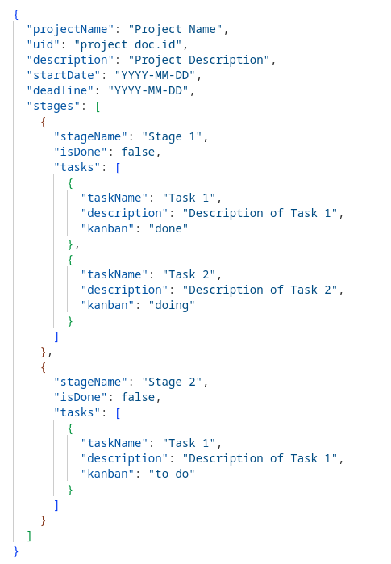
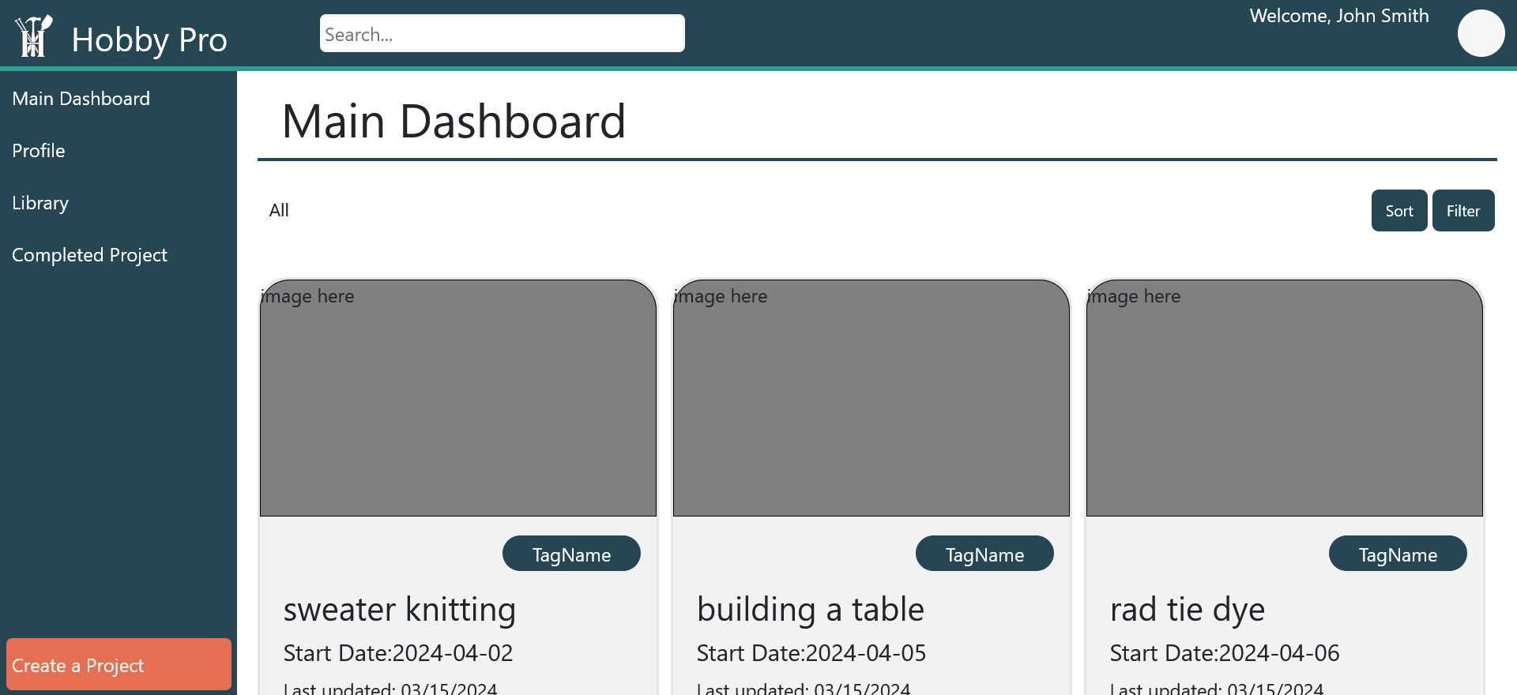
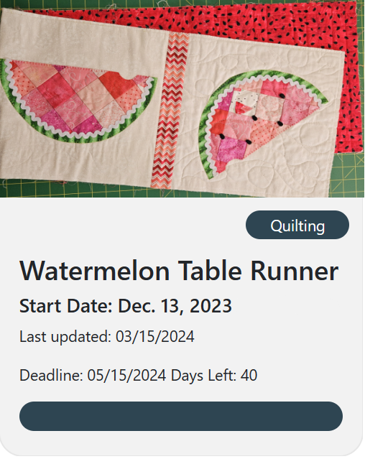
HobbyPro
Candelario Aguilar Torres, Yazmin Alvarado, Dustin Bailey, Samuel Fletcher
Dept. Of Computer Science and Information Technology
Abstract
Design
Future Work
HobbyPro is a web-based, mobile-friendly project management application created for individual hobbyists. Core features include an intuitive interface to manage multiple projects within one repository. Hobbyists can create projects and add as many “stages” to break down projects into manageable work. This allows hobbyists to tailor each project to their individual needs easily. To further promote the idea of tailoring each project, hobbyists can set deadlines within their projects and track the time spent. Within each stage, hobbyists can add tasks to a kanban board to help visualize work and maximize efficiency. Notes, documents, and images can be added as needed to the project or individually in a library to serve as inspiration for future projects. Utilizing visualization tools, Hobby Pro displays a progress bar for each project to identify how far along a project has been completed. Hobby Pro’s goal is to streamline tracking and project organization by providing a centralized space for users to manage all aspects of their hobbies efficiently.
The design layout underwent several iterations before ultimately adopting a dashboard view, which aligned with our requirements and provided the most comprehensive data visualization. Our project icon is a straightforward card layout containing essential project information such as the project’s name, start date, last update date, and deadline if added with days left. Hobbyists can categorize their projects by adding tag names to their projects which in turn were added to the icon. Additionally, a progress bar was included in the project icon to help visualize project progress. We set out to develop HobbyPro as a flexible project management tool that can be used for any hobby. As a result, we focused on keeping the design of the Project’s Page simple, incorporating common tools like note-taking and image uploading. Additionally, we included a kanban board to help users visualize work and organize tasks. All of these features are accessible within each “stage”, which users can add or remove as needed.
The HobbyPro team hopes to enhance our website by implementing a community support feature that enables users to share and view other user projects. This will provide users with inspiration for their next big project, as well as the ability to rate and download projects from the community page. Additionally, we are looking to create a space for users to follow and message each other, fostering communication and collaboration within the HobbyPro community.
Figure 1: Image of the Main Dashboard
Background
In Designing HobbyPro we aimed our attention to hobbyists taking on their everyday projects they spend hours on. We are ensuring users of our software website known as HobbyPro an easy way to keep track of project progression and ensure you know which step of the project you are on at every stage of the project. With each project the user makes they can add stages and add tasks to each stage to ensure that each part of their project is documented so they know what to do for each task and stage they make. With HobbyPro we hope to reach out to hobbyist to show them an easier way to manage their projects
Figure 3: An example of the database schema showcasing data nesting
Technology
References
HyperText MarkUp Language (HTML): The standard mark-up language used to define the structure of a webpage.
Cascading Style Sheets (CSS): The standard language used the describe the presentation of elements within a webpage. This can include color, font, size, position, and various other effects.
Vue.JS: A JavaScript framework that offers a component-based programming model which allows developers to build complex user interfaces.
Bootstrap: A CSS library used to create responsive mobile-friendly web applications.
Firebase Authentication: A Firebase module that provides authentication and authorization services that integrate with various systems. Firebase authentication leverages industry standards such as Oauth2.0 and OpenID Connect.
Firebase FireStore: A scalable, NoSQL databased designed to integrate with mobile, web, and server platforms.
Firebase Cloud Storage: An object storage service used to store user generated content such as photos, images., videos and PDF's.
https://developer.mozilla.org/en-US/
https://vuejs.org/
https://getboostrap.com/
https://firebase.google.com/
Figure 2: Project Icon that appears on the Main Dashboard
Acknowledgements
We would like to thank Dr. Karen Meisch for her support of students in the College of Science, Technology, Engineering & Mathematics, and Dr. Leong Lee for his support of students in the Department of Computer Science and Information Technology, and Dr. Nicholson for his support of students.

